Slide 1
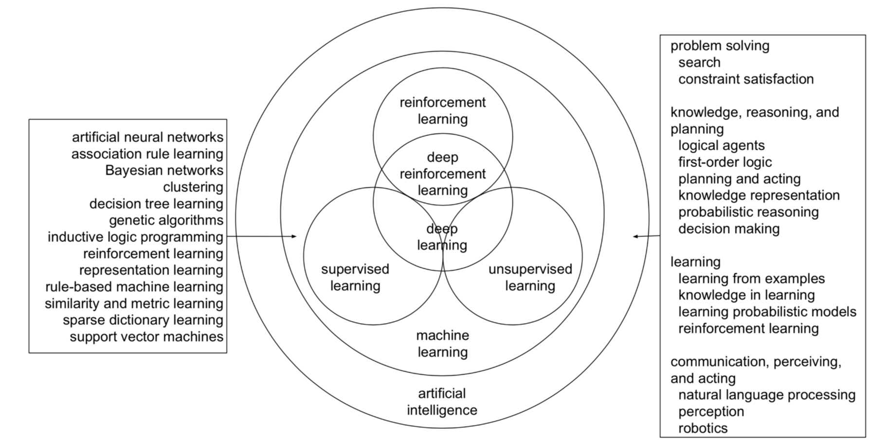
AI, ML, DL, RL

Slide 2


Slide 3


Slide 4
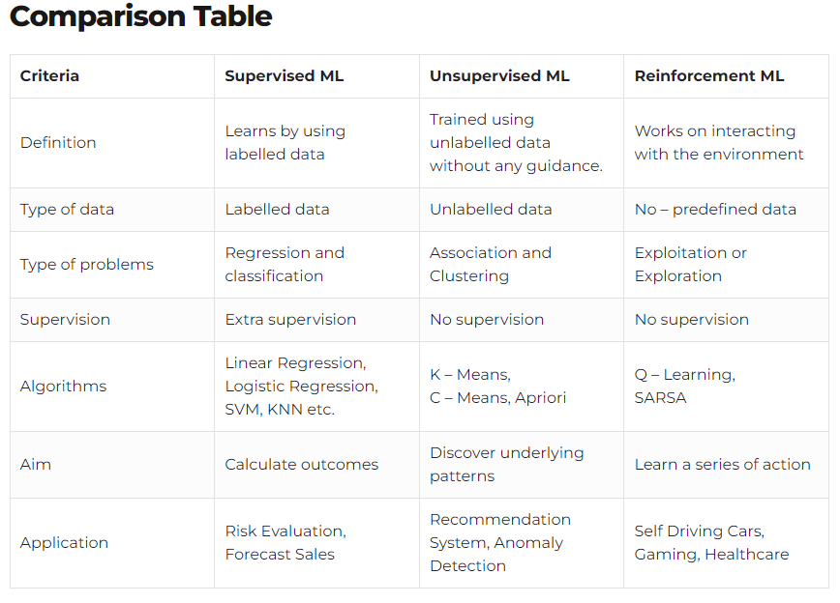

Slide 5
Understanding various learning approaches in Machine learning
Supervised learning (Linear, Logistic, Ensemble)
Age | Weight
24 | 55 Kg
30 | 57 Kg
34 | 62 Kg
38 | 65 Kg
42 | 68 Kg
46 | 70 Kg
50 | 75 Kg
Age | Weight category
24 | Slim
30 | Slim
35 | Fit
40 | Fit
Classification Binary Class
Regression use case
Classification Multi Class
Age | Weight category
24 | Slim
30 | Slim
35 | Fit
40 | Fat
45 | Fat
Dependent feature is Continuous Variable

Slide 6
Un-Supervised learning (K Means , Agglomerative, PCA,LDR)
Age | Weight
24 | 55 Kg
30 | 57 Kg
34 | 62 Kg
38 | 65 Kg
42 | 68 Kg
46 | 70 Kg
50 | 75 Kg
55 | 73 Kg
60 | 70 Kg
65 | 65 Kg
68 | 60 Kg
70 | 55 Kg
72 | 50 Kg
Young and healthy
Middle Age and healthy
Grouping the data
Clustering
Old and unhealthy
What is Dimensionality Reduction????
Number of features can be trimmed
if the dataset contains 1000 features, it can be reduced into 100 features without losing semantics
Minimum Data Leakage
No Dependent feature or target

Slide 7
Linear Regression – Intuition
Train Dataset
**Consider dataset contains one feature and target.
Model Building and Validation
Y
Best Fit line
Hypothesis
Prediction , y*
New Input
Prediction
New input
X
Y is linear function of X
Equation of best fit line :
y* = mx+c
Where m = coefficient , c = intercept

Slide 8
Intercept and Coefficient
Equation of best fit line :
y* = mx+c
Coefficient :
Unit movement with respect to both x-axis and y-axis
Otherwise known as ‘weight’ of the feature
Intercept :
Point best fit line intersecting y axis
When x = 0, Y* = c
Otherwise known as ‘bias’ of instance
Y
Coefficient
Intercept
X

Slide 9
Understanding best fit line:
Features |  | Target
x1 | x2 | y
40 | 73 | 105
31 | 59 | 145
81 | 18 | 128
58 | 69 | 116
---- | --- | ---
66 | 20 | 144
For a multi feature dataset, Vectors are
x1 = [40 31 81 58 --- 66]
x2 = [73 59 18 69 --- 20]
Y = [105 145 128 116 --- 144]
In a linear regression model, every feature has an assigned “weight”. Which parameterize each feature in the dataset.
Generic Prediction formulae:
Y* = c + m1 x1 + m2 x2 + -------- + mn xn
Where,
Y* = The approximate value of the output y (prediction)
m1,m2 ---- mn
where i = [1,2, -------, n], is the weight assigned or co-efficient to each feature in the dataset
‘c’ represents the ‘bias’ term or intercept
The weights in the dataset are adjusted to take on values that capture the underlying relationship between the features that optimally approximates the target variables.

Slide 10
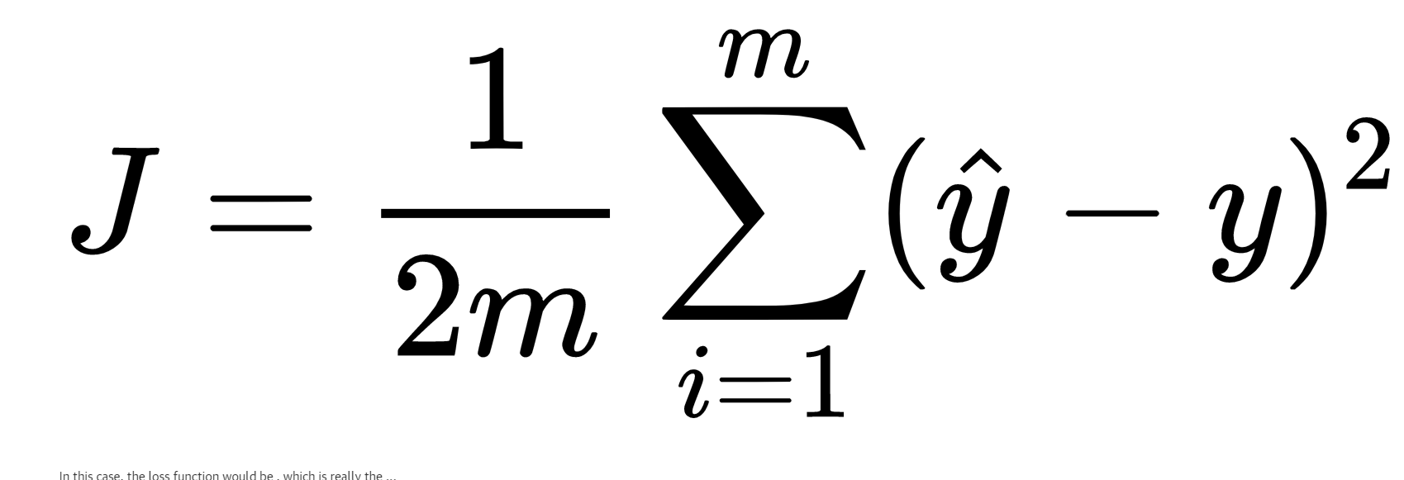
Optimize Best fit line and Cost function
Y
The Goal of the linear model is to find a line that gives the best approximation or best fit to the data points.
The line of best fit is known as the regression line.(i.e Prediction line)
What needs to be done to minimize the cost error i.e residuals between prediction and actual target values.
If all data points fall on the predicted regression line the error will be 0.
In interpreting the regression model, want the error measure to be as low as possible
X
Distance between data points to prediction line is known as ,
residuals (or)
cost error
Cost function
Linear model - Cost function is defined as half the sum of the squared difference between the predicted value and the actual value.
Where m = Total number of datapoints
y –hat = Prediction for each x
y = Actual for each x

Slide 11
Cost function to Convergence
The closer the approximate value of the predicted target variable is to the actual target variable , cost function will be lowered and model will be better.
Having defined the cost function, an optimization or convergence algorithm such as Gradient descent is used to minimize the cost function by updating the weights of the linear regression model.
Understanding Gradient Descent: (Repeat Until Convergence)
Gradient Descent can be constructed between cost function and coefficient
Initialize coefficient at particular limit and let it change during convergence
J(m)
Global Minima or Local Minima
m

